Slide 1
Children's Book Council of Australia
(Qld Branch)
Readers Cup Example

Slide 2
Rules
All questions are 30 seconds in length, unless otherwise indicated.
When you are asked to stop writing, you are to immediately raise your piece of paper in the air.
3. Only a maximum of 4 people per round.
4. If you are the person sitting out during the round, you are not to communicate with your team members. Likewise, team members are not to ask the sitter outerer (yes that’s now a new word) to help with the answer.
4. Whisper! We don’t want you giving the answers away to other teams ☺
5. HAVE FUN! Yes, there will be a 1st, 2nd and 3rd place getter but this competition is designed for you all to enjoy.

Slide 3
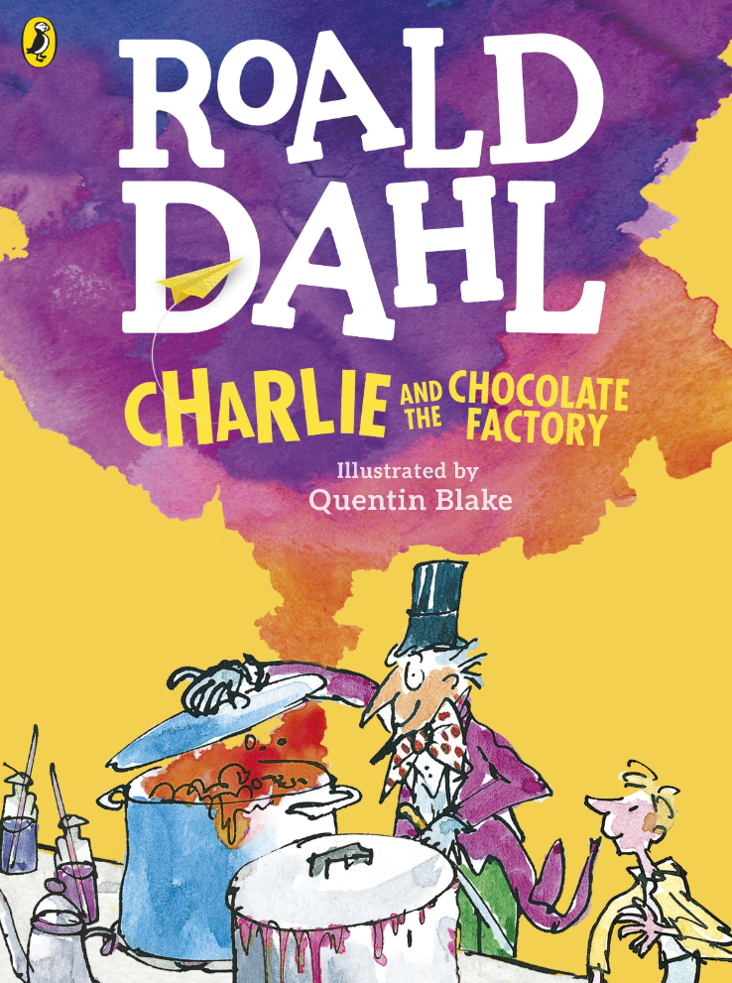
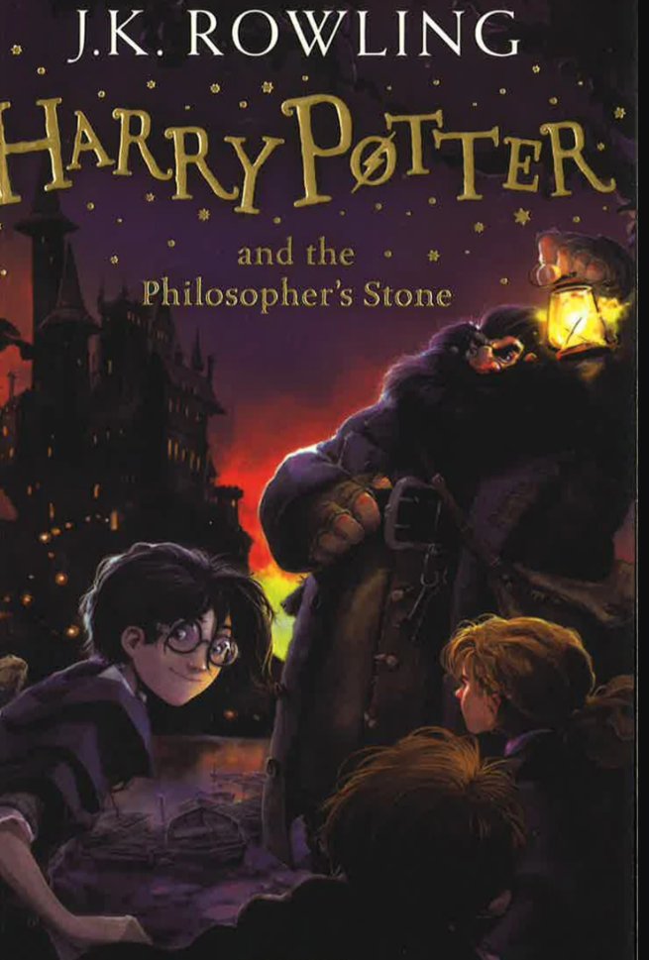
ROUND 1

Slide 4
Round 1
Question 1
How many staircases at Hogwarts?
There were doors that wouldn’t open, unless you did what to them?

Slide 5
Round 1
Question 2
What did Charlie find buried under the snow? What did it look and feel like?

Slide 6
Round 1
Question 3
The first envelope Harry received was thick and heavy, made of yellowish parchment and the address was written in emerald-green ink. Describe what was on the other side.

Slide 7
Round 1
Question 4
Willy Wonka was inventing a new line of toffee. What was the saucepan full of?

Slide 8
Round 1
Question 5
Harry had never seen such a Christmas dinner. Name four items on the table.

Slide 9
Answers
Round 1 – Question 1
How many staircases at Hogwarts? 142
There were doors that wouldn’t open unless you did what to them?
Asked politely or tickled them in exactly the right place.

Slide 10
Answers
Round 1 – Question 3
What did Charlie find buried under the snow? What did it look and feel like?
Five-pence piece; damp and dirty.

Slide 11
Answers
Round 1 – Question 1
The first envelope Harry received was thick and heavy, made of yellowish parchment and the address was written in emerald-green ink. Describe what was on the other side.
A purple wax seal bearing a coat of arms; a lion, an eagle, a badger and a snake surrounding a large letter ‘H’.

Slide 12
Answers
Round 1 – Question 4
Willy Wonka was inventing a new line of toffee. What was the saucepan full of?
Thick gooey purplish treacle, boiling and bubbling.

Slide 13
Answers
Round 1 – Question 5
Harry had never seen such a Christmas dinner. Name four items on the table.
a hundred fat, roast turkeys
mountains of roast and boiled potatoes
platters of fat chipolatas
tureens of buttered peas
silver boats of thick, rich gravy and cranberry sauce
stacks of wizard crackers.

